Slide 1

Blinkit Analysis: Driving Growth
Leveraging data for smarter grocery delivery decisions.

Slide 2
Project Overview
Key Metrics
Data-Driven Decisions
Impact Analysis
Sales, item count, ratings, sales breakdown.
Optimize operations, reduce costs, improve forecasting.
Understand how outlet type, size, location, and item type affect sales.

Slide 3
Dataset Summary & KPIs
Our dataset comprises 8524 rows, providing a comprehensive view of business transactions.
Handled missing values for item weight, outlet size, and ratings.
Interactive slicer panel for detailed segment exploration.
$1.2M
$140
8523
4.0
Total Sales
Average Sales
No. of Items
Avg. Rating

Slide 4
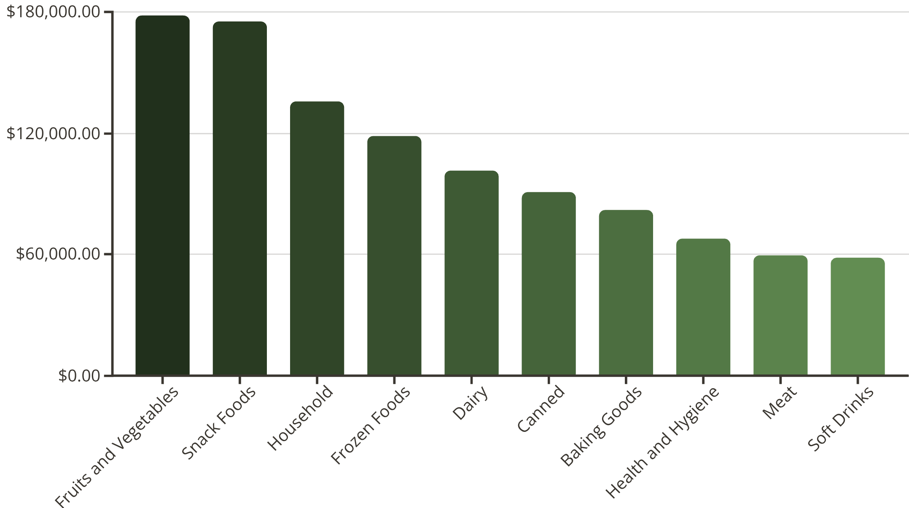
Sales by Item Type
Revenue breakdown by product category reveals top performers:
Fruits and Vegetables: $178K
Snack Foods: $175K
Household: $136K
Frozen Foods: $119K
These categories drive significant revenue.

Slide 5
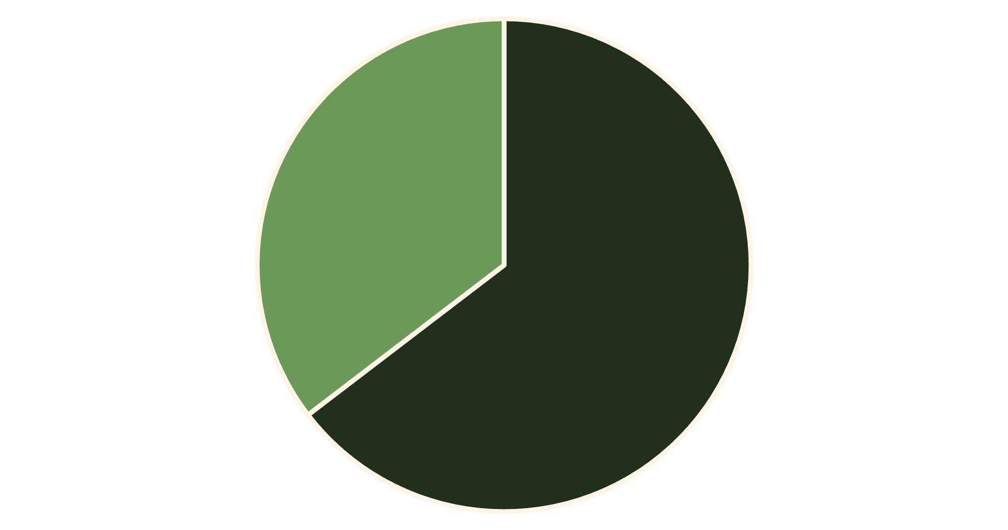
Fat Content & Sales
Consumer preferences show a clear trend:
Low Fat: $776K in sales
Regular: $425K in sales
Low Fat products significantly outperform Regular products.
Low Fat
Regular

Slide 6
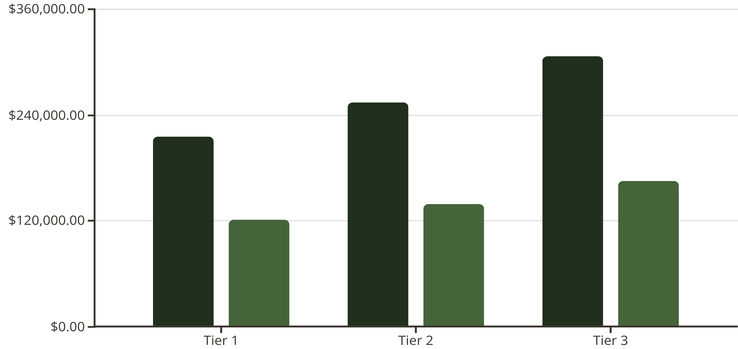
Fat Content by Outlet Location
Regional dietary trends show Low Fat sales consistently higher across all tiers.
Tier 3: Highest sales for both Low Fat and Regular.
Tier 1: Lowest sales for both categories.
This indicates a general preference for healthier options.
Low Fat
Regular

Slide 7
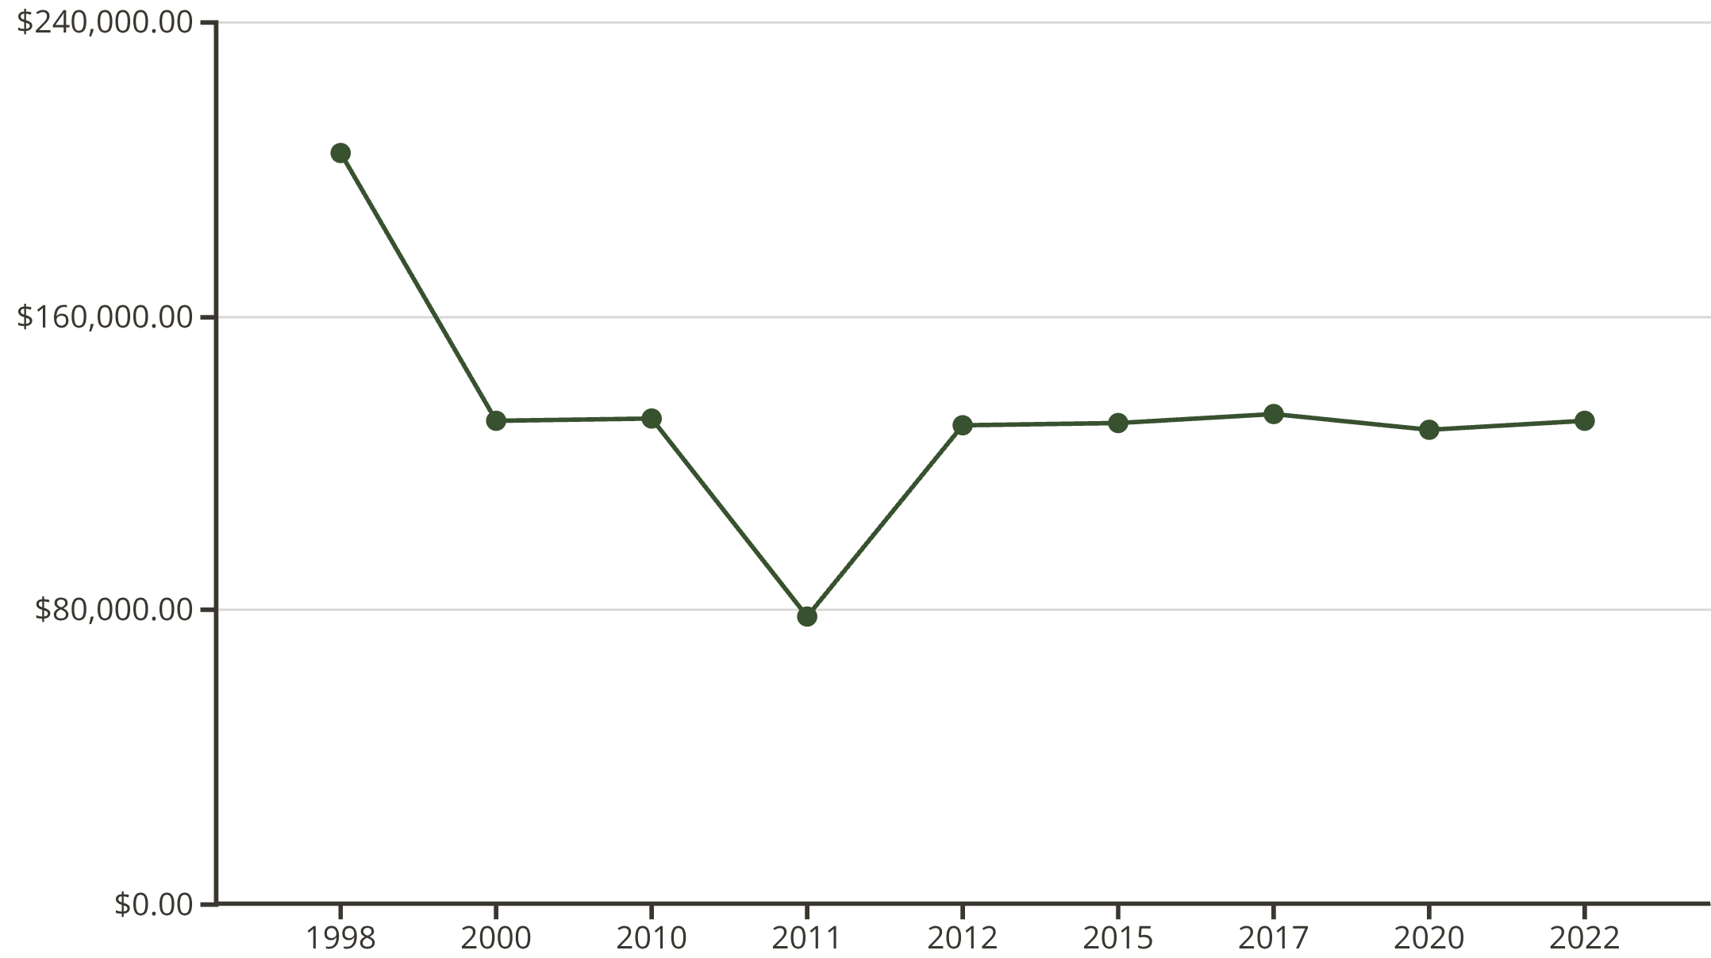
Sales by Outlet Establishment Year
Performance varies significantly by establishment year:
1998: $204K
2011: $78K
Newer stores (2020, 2022): Around $130K
Long-standing outlets often show stronger revenue.

Slide 8
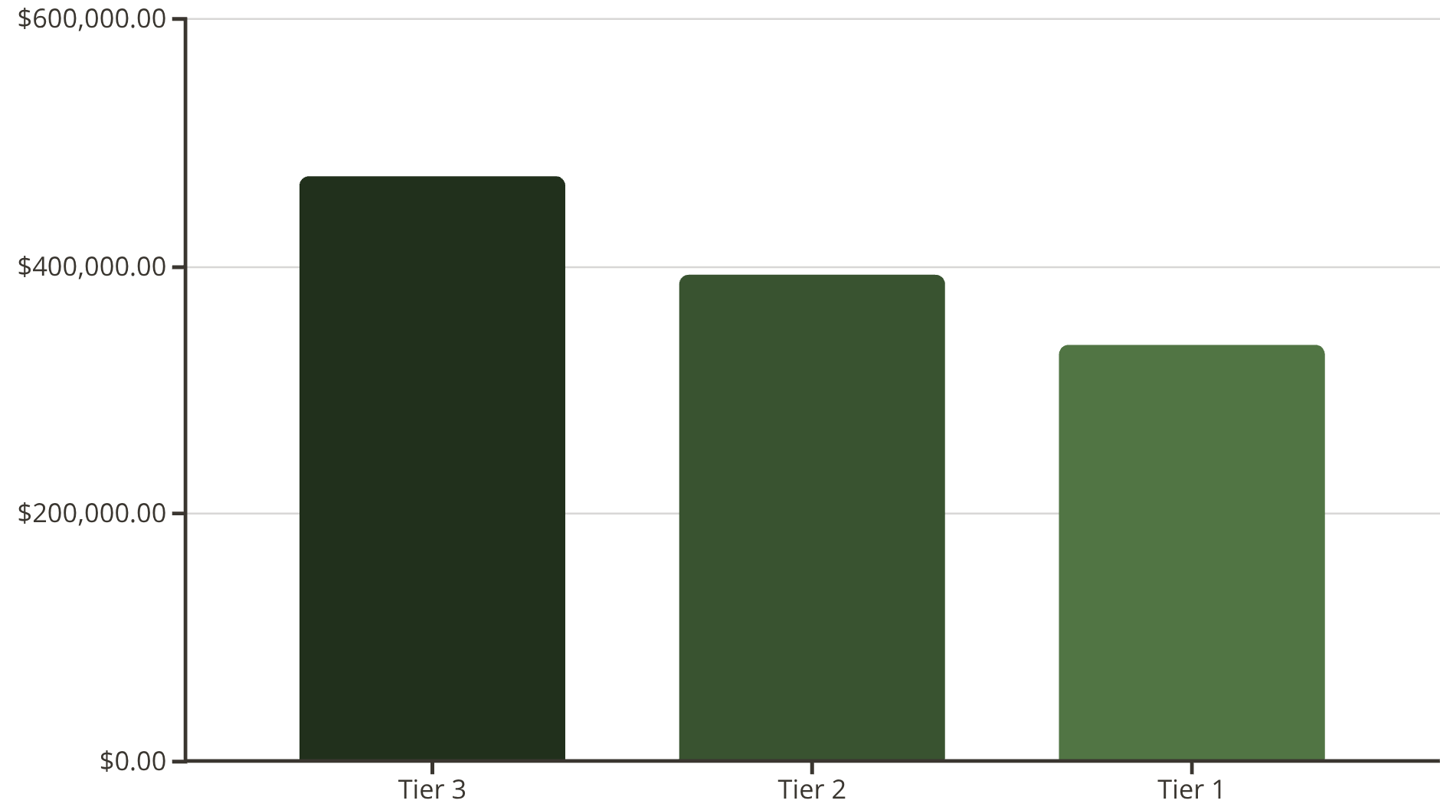
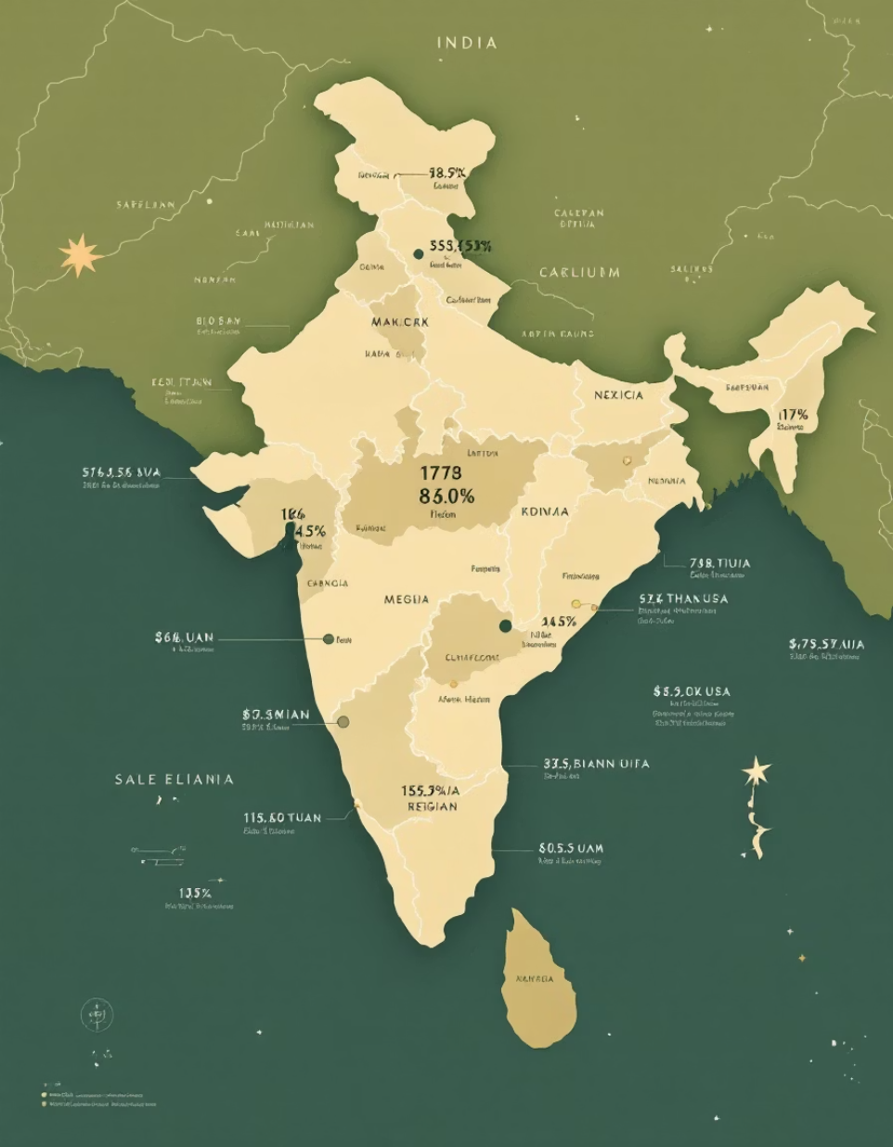
Sales by Outlet Location & Size
Geographic tiers show varying profitability:
Tier 3: Most profitable ($472K)
Tier 1: Least profitable ($336K)
Outlet size also impacts sales, with Small and High performing well.

Slide 9

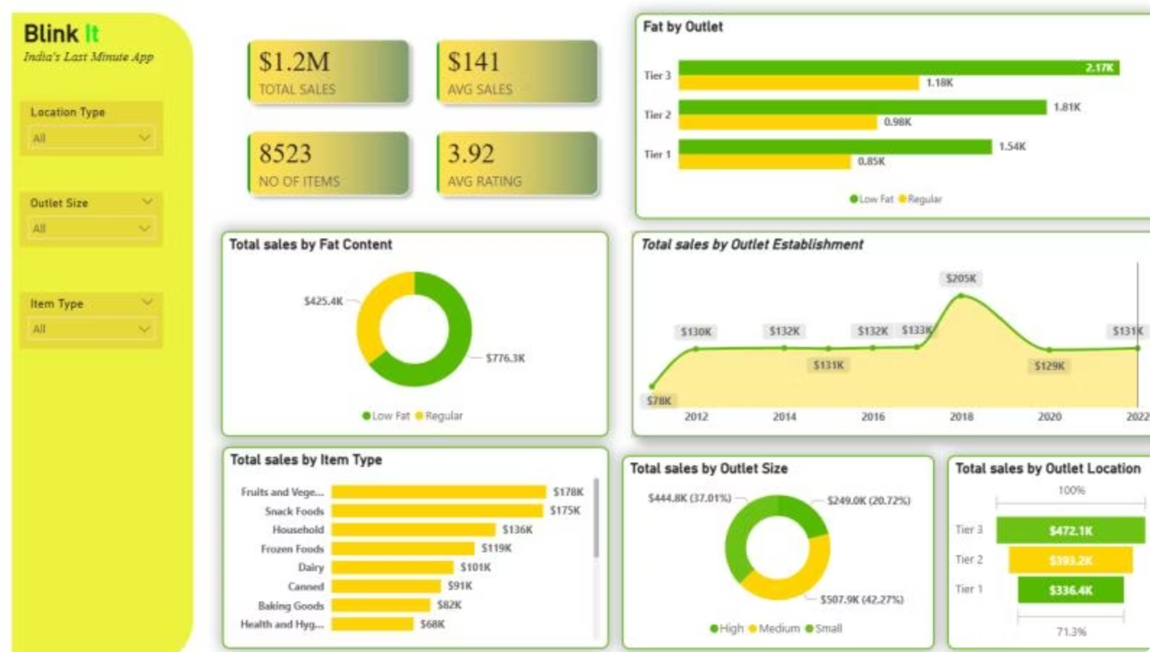
Dashboard Insights
Interactive Power BI dashboard provides visual insights:
Total sales by fat content: Low Fat ($776.3K) vs. Regular ($425.4K)
Sales by outlet tier: Tier 3 ($2.17K), Tier 2 ($1.81K), Tier 1 ($1.54K)
Sales by item type: Fruits & Veggies, Snack Foods, Household are top.
Sales by outlet establishment year: Peak in 2018 ($205K)
Sales by outlet size: Small ($507.9K), High ($444.8K), Medium ($249.0K)

Slide 10

Business Recommendations
Focus on High-Performing Outlets
Optimize Low-Performing Outlets
Promote High-Margin Items
Prioritize Supermarket types for marketing and inventory.
Review pricing, product mix, and promotions; reduce assortment if needed.
Increase visibility for top-selling categories; use cross-sell bundles.
Improve Customer Experience
Strengthen Data-Driven Decisions
Leverage high ratings in marketing; address issues for lower-rated items/outlets.
Refresh dashboards monthly; turn insights into actions with deadlines.

